Slide 1
Material Design Lite

Slide 2
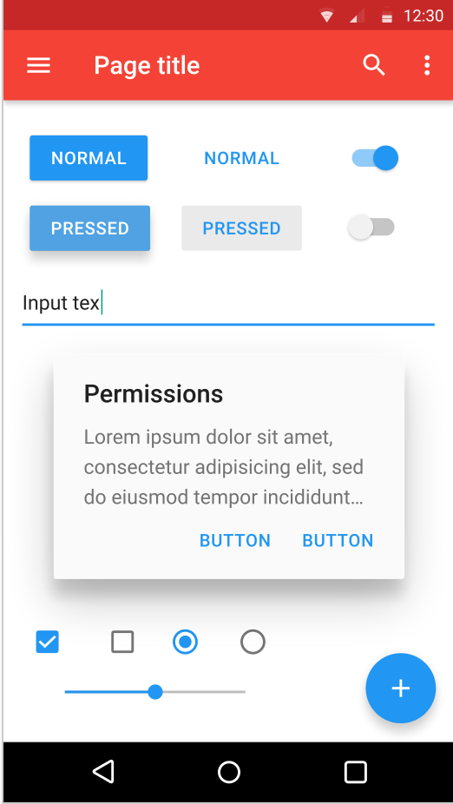
What is Material design
Developed in 2014 by Google
Expanding upon the "card" motifs that debuted in Google Now
Makes more liberal use of grid-based layouts, responsive animations and transitions,

Slide 3
Material design Lite key features
Add a Material Design look and feel to your websites
Doesn’t rely on any JavaScript frameworks
Aims to optimize for cross-device use

Slide 4
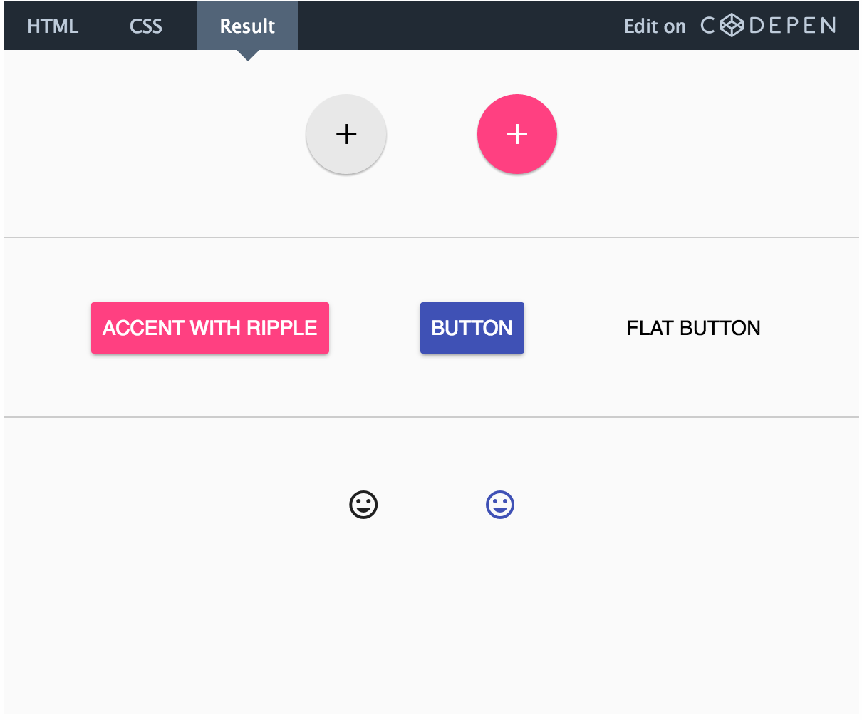
Examples:
Basic button
Flat button
Float action button(Unique to MDL)

Slide 5
Summary
Front-end component library
A lightweight implementation of the Material Design spec

Slide 6
References
https://webdesign.tutsplus.com/articles/an-overview-of-material-design-lite--cms-24370
https://www.sitepoint.com/practical-introduction-material-design-lite-google/

